Slide 1


Amazon Prime+
Principles of Marketing • SB3081 • RV University
Student: Esheshwari Kumari
USN: 1RUA24BCA0025
Faculty: Prof. Shikha Karamchandani

Slide 2




Introduction to Amazon Prime+
Need: Convenience and time-saving in digital services
Amazon Prime+ is an upgraded subscription ecosystem that combines fast delivery, streaming entertainment, exclusive shopping benefits, and smart recommendations into a single platform
Want: One platform for shopping and entertainment
Demand: Consumers subscribing to integrated digital services like Prime.

Slide 3



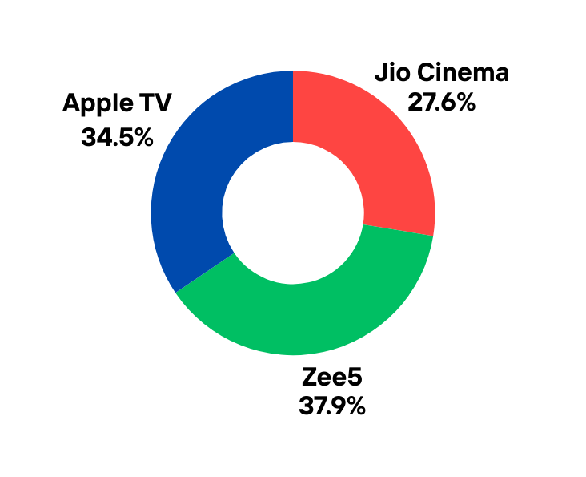

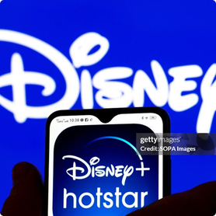
Market Intelligence
High Convinience
INDIRECT COMPETITORS
Flipkart Plus - For Retail
Swiggy One - For Essential
Low Screen Time
High Screen Time
DIRECT COMPETITORS
Netflix - The Content Specialist
Disney+ Hotstar - The Live Experience
Low Convinience

Slide 4


Market Research & Demand Insights
DIGITAL STUDENT
BUSY PROFESSIONAL
Age: 18-24
Age: 25-40
Trait - Budget-conscious, Entertainment-focused
Prime Value - Student discount, Video streaming
Traits: Time-starved, Convenience-focused
Prime Value: Fast delivery, Premium content

Slide 5
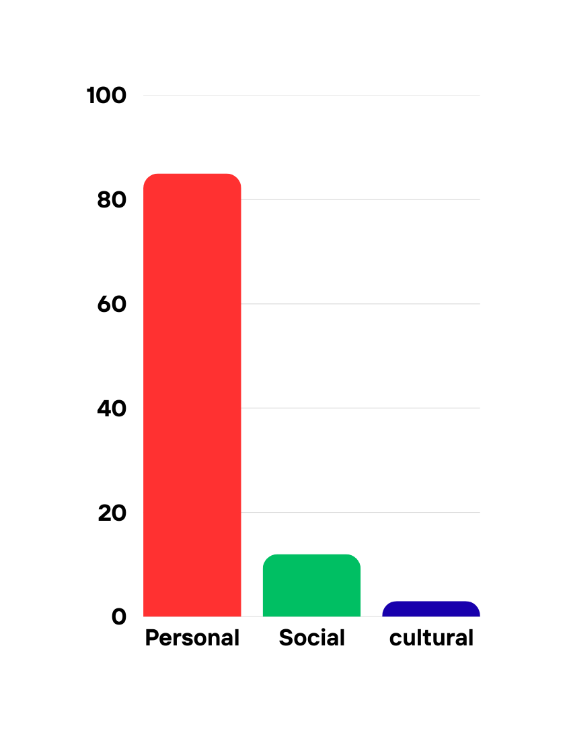




Consumer Behaviour Analysis
Personal Factors
Social Factors
Cultural Factors
-Age and life stage preferences
-Income and lifestyle choices
-Family and peer influence
-Social media and word-of-mouth
-Regional preferences and local behaviors
-Cultural norms and technology access

Slide 6





Segmentation, Targeting & Positioning (STP)
Tech Enthusiasts
Families
Students
Young Professionals
“Amazon Prime+ is the all-in-one digital lifestyle subscription that combines shopping convenience, entertainment, and exclusive benefits for modern digital consumers.”

Slide 7





Marketing Mix
High Customer Value
PRODUCT
PRICE
Integrated Ecosystem
Subscription Model
Channel & Distribution
Revenue Strategy
PLACE
PROMOTION
Digital Platform
Prime Day, Campaigns
Market Reach

Slide 8

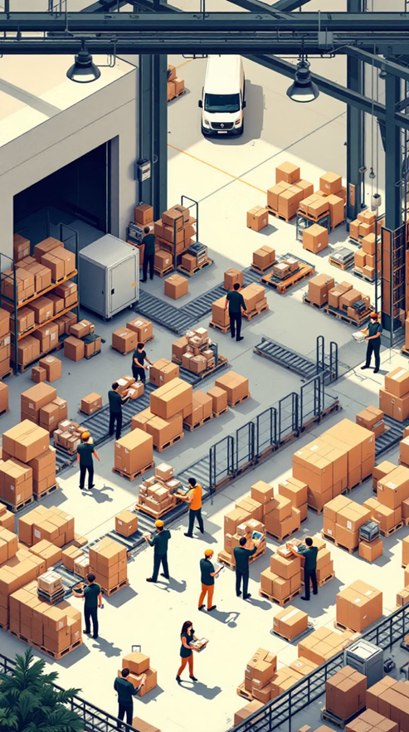
References
Amazon Prime Membership Benefits
Amazon Prime Official Page
Netflix Official Website
Netflix Mobile Plan for India – About Netflix
Amazon Prime Benefits Overview

Slide 9

THANK YOU

